Slide 1
KRCT ZERO DUES MANAGEMENT
Team Members:
1. MOHAMED ARSHATH N (811721104068)
2. RAHUL R (811721104081)
3. SASIKANTH U (811721104305)
Guided By:
Mr.R.Rajavarman M.E.,(Ph.D).,

Slide 2
Content
1. Objective
2. Problem Statement
3. Existing System
4. Proposed System
5. Architecture
6. Literature survey
7. Module Description

Slide 3
Objective
Efficiency Enhancement:
The primary objective of KRCT Zero Dues is to enhance the efficiency of dues management processes within the organization. By implementing a streamlined system, the aim is to reduce manual effort, minimize errors, and optimize resource allocation.
Cost Reduction:
By optimizing dues management processes and reducing manual intervention, KRCT Zero Dues aims to lower operational costs associated with dues collection and administration. This helps the organization allocate resources more effectively and maximize cost savings.
Timely Dues Collection:
Another key objective is to ensure the timely collection of dues from individuals or entities associated with the organization. This includes college fees, hostel fees, bus fees, outstanding balances, and any other financial obligations.
Transparency and Accountability:
KRCT Zero Dues aims to promote transparency and accountability in financial transactions by providing clear visibility into dues status and payment history. This helps build trust among stakeholders and fosters a culture of financial responsibility.

Slide 4
Problem Statement
The current system utilized by KRCT administration for managing dues lacks efficiency, leading to various challenges.
Manual processes, disparate data sources, and lack of automation contribute to delayed payments, inaccuracies in tracking dues, and administrative burdens.
Manual handling of dues-related tasks results in inefficiencies and errors, consuming valuable administrative resources.
The absence of automation exacerbates these challenges, leading to increased workload and reduced productivity.

Slide 5
Existing System
NO DUES MANAGEMENT SYSTEM
The project no Dues Management System is fully fledged web based application software. The main features of this software deals with the security and the authorization of the user. No dues Management system stores the no-dues certificate of the employee who is resigning the company. As per users authorization there are various modules that are used by the user for the uploading and downloading of the document.This application is basically the destination from where the faculties can withdraw any required information of any student from the batch.
USERS:
STUDENT : Students are supposed to get their no dues cleared from each department at the end of the degree

Slide 6
Proposed System
Administrator Module:
Registration of students and authorities into the system database.
Creation of login credentials for authorities with unique user IDs and passwords.
Department Module:
Maintenance of detailed records of items borrowed, return dates, and associated fines or dues.
Automatic generation of no dues forms based on clearance status.
Student Module:
Access to personal dues status and clearance history.
Submission of clearance requests and tracking of clearance progress.

Slide 7
Proposed System
Technology Stack:
Frontend: HTML, CSS, JavaScript
Backend: PHP
Database: SQL

Slide 8
Architecture
DATABASE (details about student)
CLIENT (Client Interface)
Web Server
(PHP)
Authentication and Authorization
Data Processing
ZERO DUES FORM

Slide 9
Literature survey
S.NO | TITLE | AUTHOR | YEAR OF PASSING | REMARKS
1. | The Role of Technology in No Dues Management | Emily Johnson | 2018 | Examines the impact of technology on no dues systems
2. | Streamlining No Dues Processes | Michael Smith | 2019 | Proposes methods for improving no dues management

Slide 10
Literature survey
S.NO | TITLE | AUTHOR | YEAR OF PASSING | REMARKS
3. | A Comparative Study of No Dues Systems | Jennifer Lee | 2020 | Compares different approaches to no dues management
4. | Challenges in Implementing No Dues Policies | David Williams | 2017 | Identifies common obstacles in no dues management

Slide 11
Literature survey
S.NO | TITLE | AUTHOR | YEAR OF PASSING | REMARKS
5. | Automation in No Dues Clearance | Samantha Brown | 2021 | Investigates the use of automation in the process

Slide 12
Modules In Project
LOGIN PAGE
WELCOME PAGE
CHECK BALANCE
ZERO DUES DOWNLOAD
ZERO DUES VIEW
CREATE USER PAGE
CHANGE PASSWORD
DATABASE MANAGEMENT

Slide 13
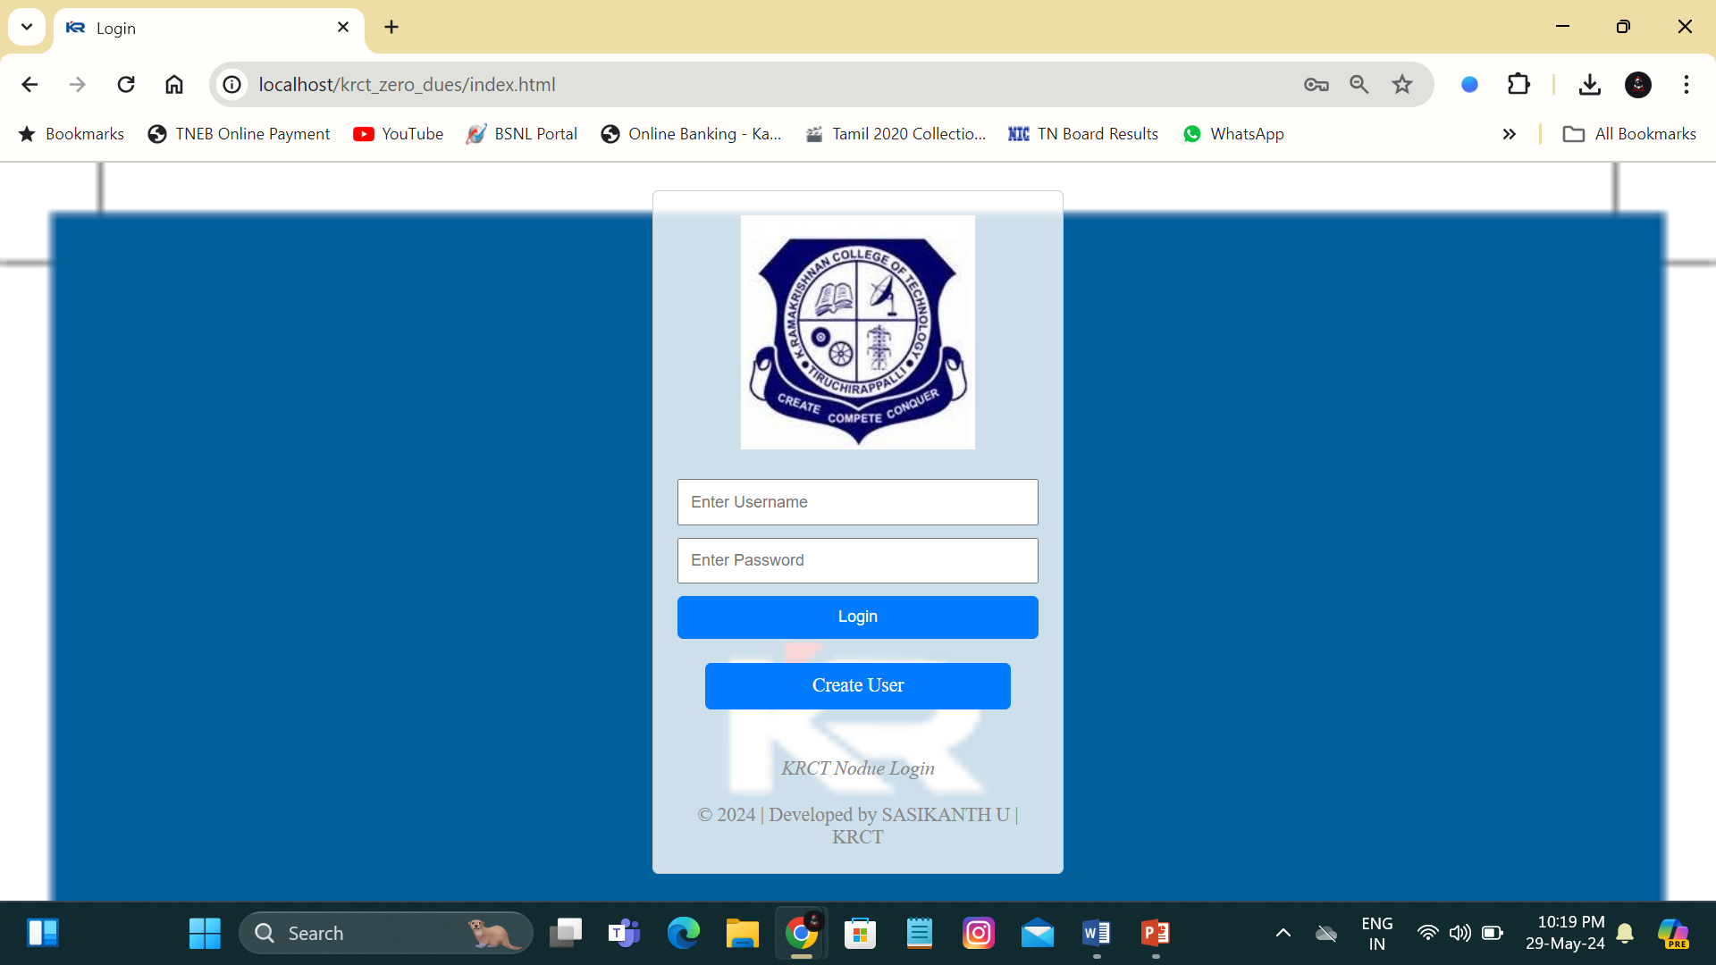
Login page
The "KRCT Zero Dues Management" frontend page is a simple and intuitive interface designed for user management. It features fields for entering a username and password, facilitating secure access and user authentication. The page also includes a "Create User" button, enabling administrators to easily add new users to the system. The clean and minimalist design ensures a user-friendly experience, with a focus on ease of navigation and clarity. This page is essential for managing user accounts within the KRCT Zero Dues system, ensuring that only authorized individuals can access and manage dues-related information.

Slide 14
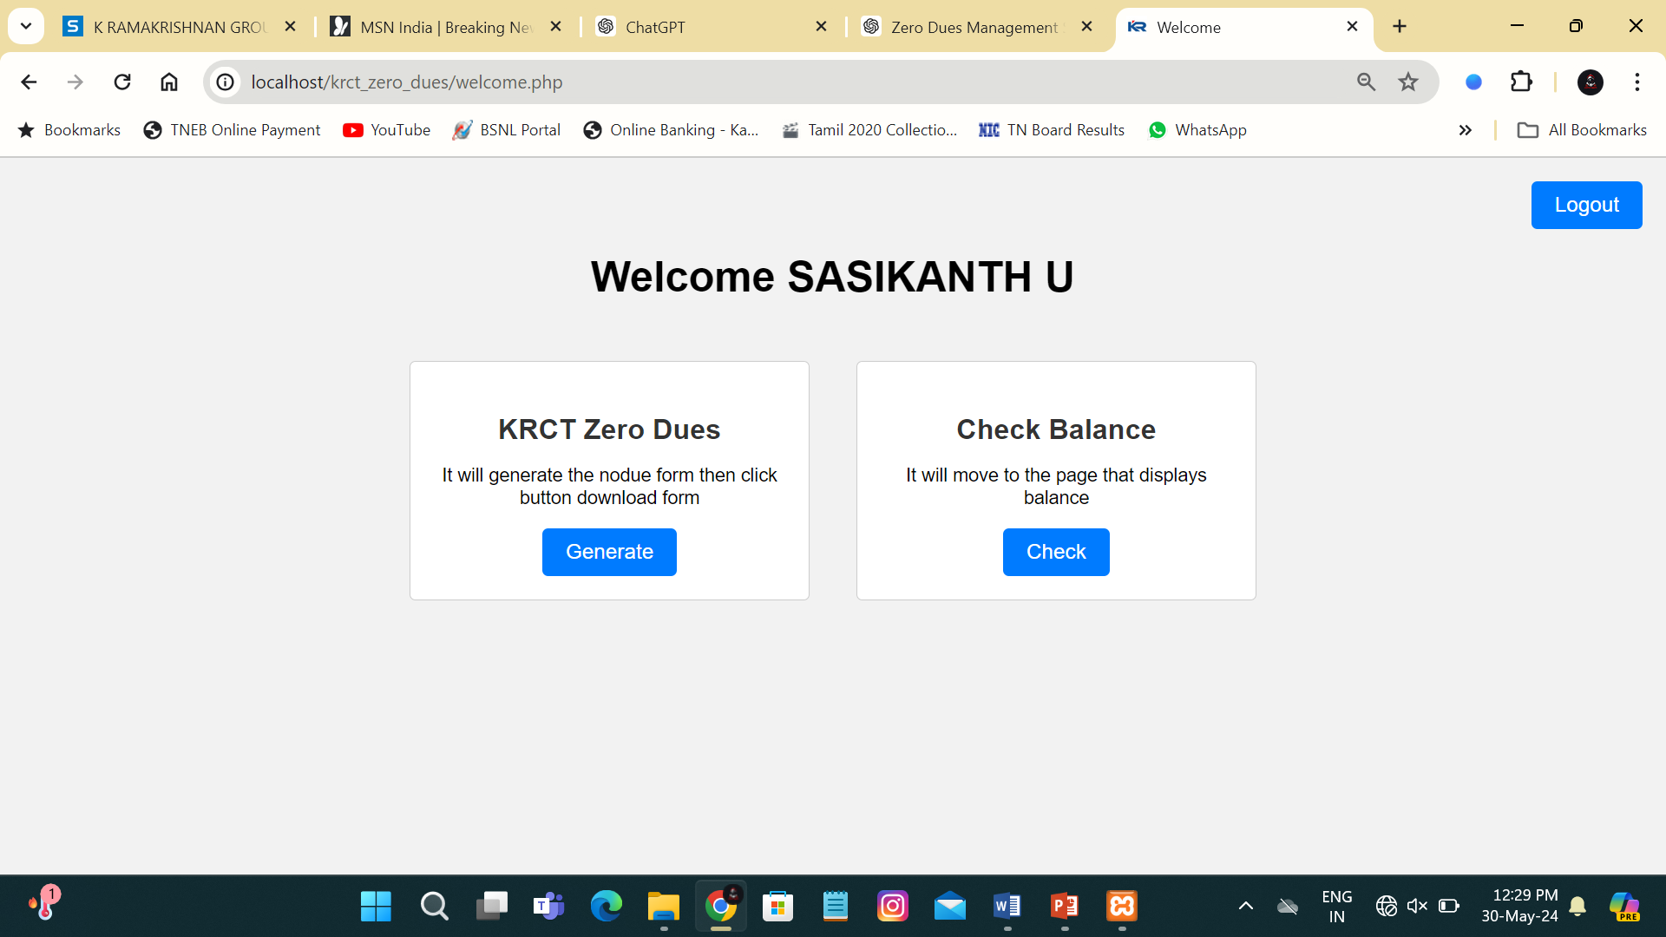
Welcome Page

Slide 15
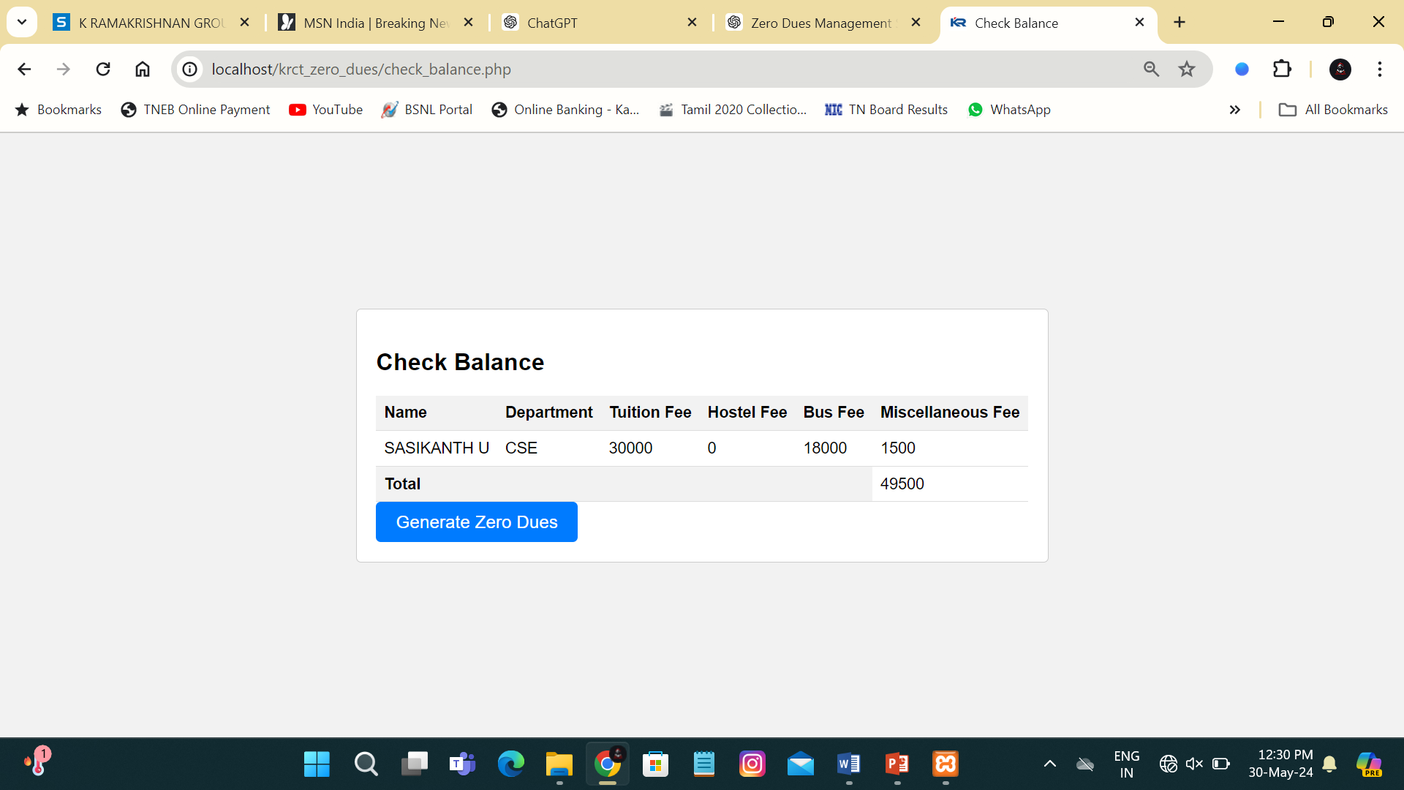
Check Balance

Slide 16
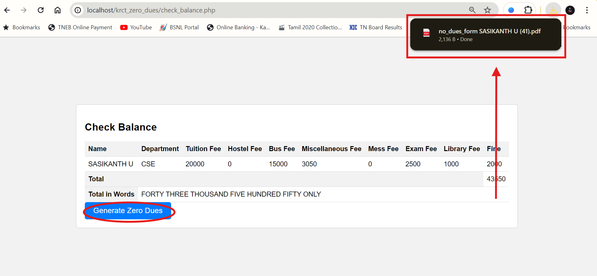
Zero Dues Download

Slide 17
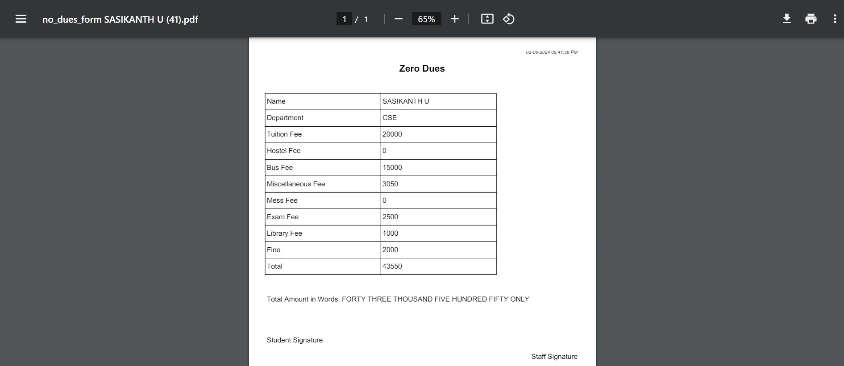
Zero Dues Pdf

Slide 18
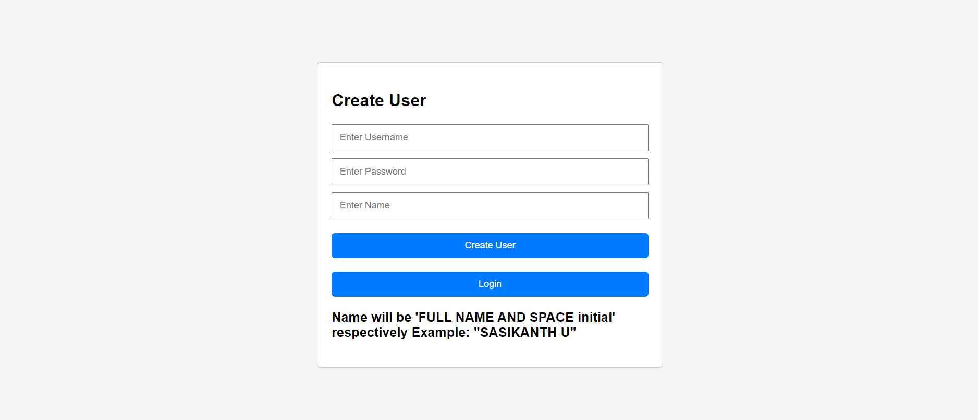
Create User Page

Slide 19
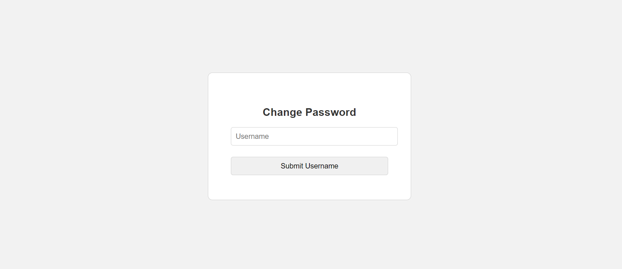
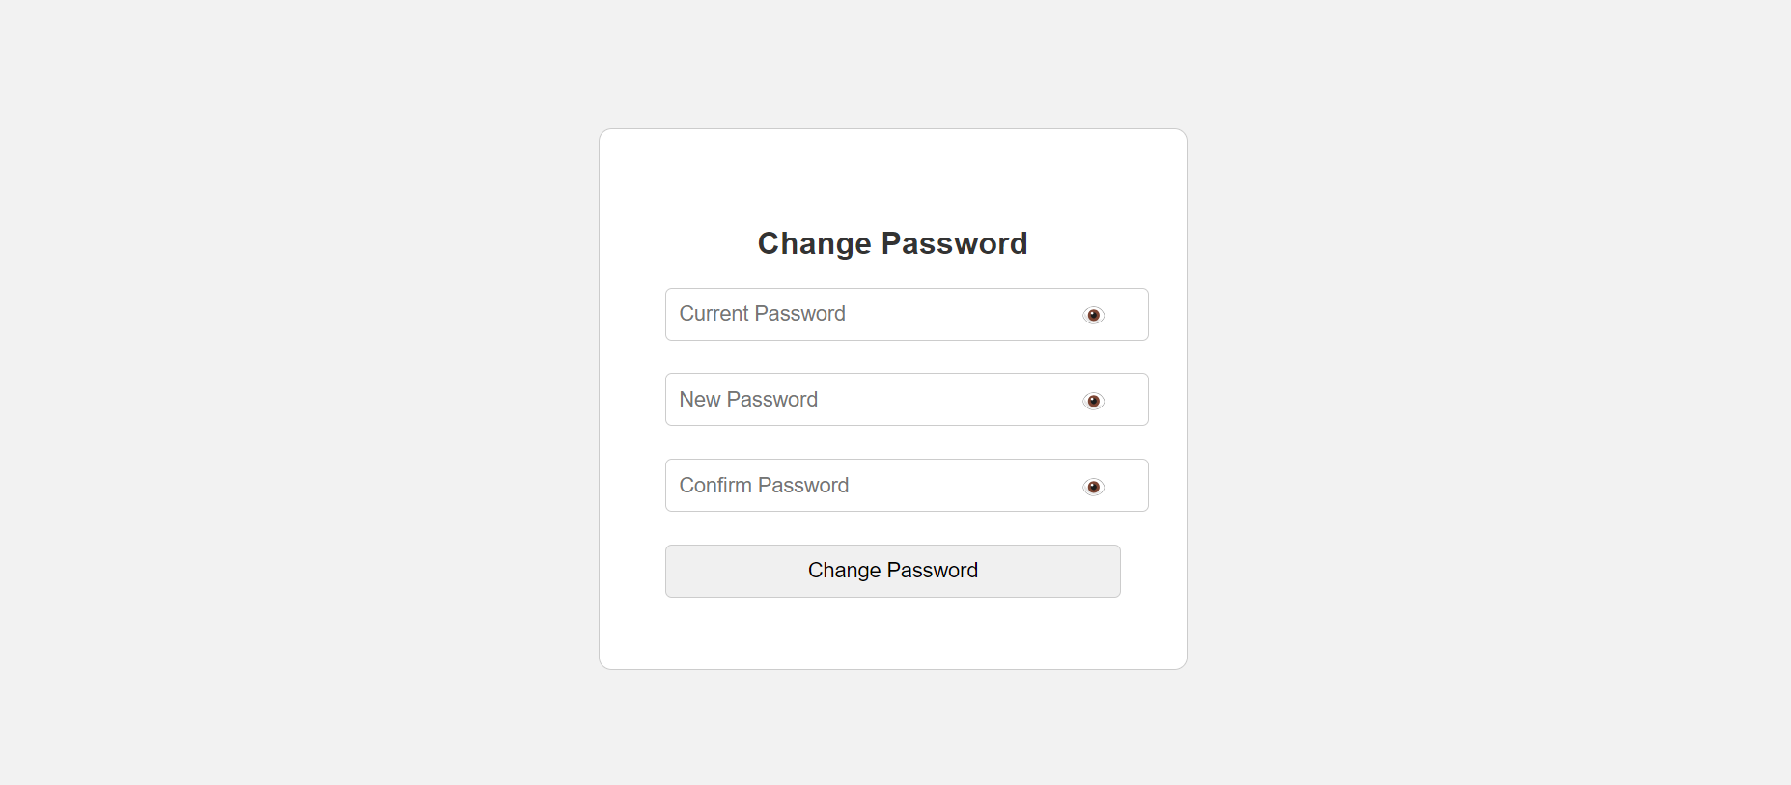
Change Password

Slide 20
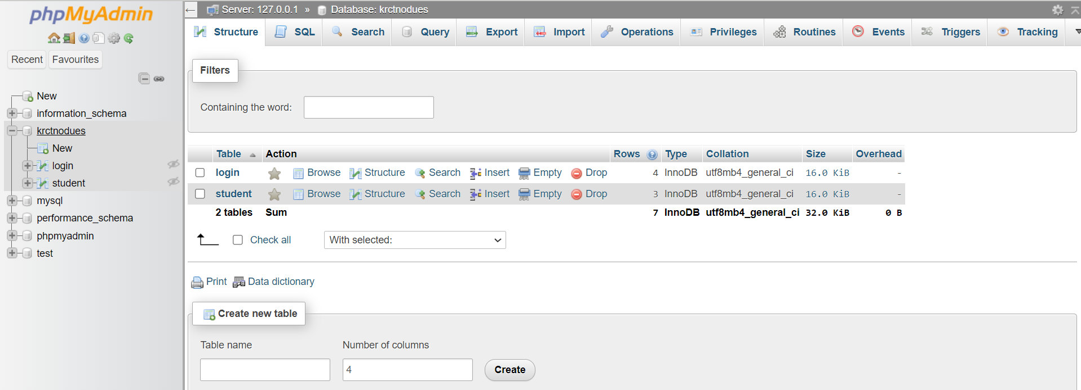
Database Management

Slide 21
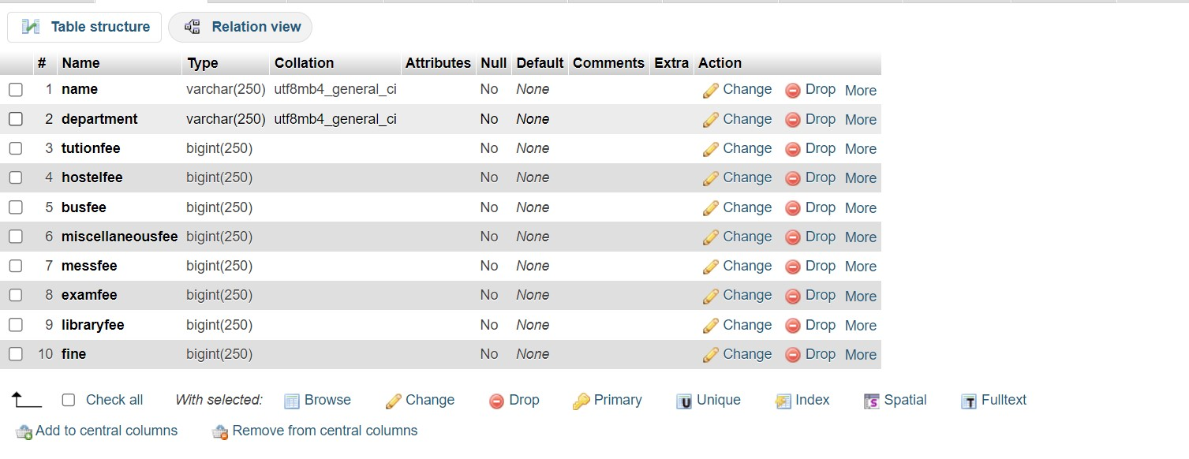

Slide 22
Future Enhancement
Enhanced Data Analysis:
Detailed Reports: Implementing detailed reporting capabilities to generate insights such as
monthly dues collection, overdue payments, and trend analysis.
Automated Notifications:
Email and SMS Alerts: Implementing automated notifications to remind users of upcoming due
dates or alert them of overdue payments.
Payment Gateway Integration:
Online Payments: Integrating a payment gateway to allow users to pay their dues online directly through the system.
Enhanced Security:
Two-factor Authentication: Implementing two-factor authentication for an additional layer of security during the login process.

Slide 23
References
1.PHP Documentation:
Official documentation for PHP, which includes detailed explanations and
examples.
PHP Manual
2. XAMPP Documentation:
Instructions for setting up a local development environment using XAMPP, which
includes Apache, PHP, and MySQL.
XAMPP Documentation
3. FPDF Library:
A PHP class to generate PDF files, useful for creating the no dues form.
FPDF Documentation

Slide 24
THANK YOU ☺

